Slide 1

Internet Technologies
ITI & XI-IT
Lesson 3: PHP
Henrik Lange

Slide 2
Agenda
JavaScript recap
Updated course plan
Assignment 1
Client Server Relationships
HTTP Protocol
Session & Cookies
Mixing PHP and HTML
Variables
If-then-else
Loops
Functions
Super Globals
Filtering
JavaScript AJAX

Slide 3
Install PHP
Mac (this should be the same on Linux, but I only tried it on Mac)
- Open the terminal (press cmd +space to open spotlight, write terminal, press enter)
- Write everything after the colon in a single line and press enter: /usr/bin/ruby -e "$(curl -fsSL https://raw.githubusercontent.com/Homebrew/install/master/install)"
- This will install "Homebrew" on your computer along with XCode command line tools. It can take a good chunk of time, so be patient.
- You might need to press enter an extra time and put in your system-password.
- If something fails, just try again
- To install PHP via Homebrew write the following in the terminal: brew install php73
- Keep Homebrew, as you will use it to install MariaDB later on

Slide 4
Install PHP
Windows
- Go to the following site: https://windows.php.net/download#php-7.3
- Select the link called "zip" in the second grey box for 64-bits, or in the 4th box for 32-bit windows
- Put the content of that zip file in a folder directly on your C drive, such as C:/php
- Inside the folder, rename the file php.ini-development to php.ini
- Open php.ini in a text editor and change the line ;extension_dir = "ext" to extension_dir = "C:/php/ext"
- yes, the leading semicolon was removed.
- Open the control panel and search for "Edit the system environment variables"
- A new windows opens, and in the bottom of it, select Environment Variables
- In the SECOND list (not the first!), select the element called "Path" and click the "Edit" button
- Click "new" and enter the php folder path: C:/php
- Click OK buttons until everything is closed and reboot your computer

Slide 5
Questions from last time
Create a text file with the following content:
<?php echo 'hello world’;
Save the text file as index.php in any folder on your computer
Open the folder that contains the .php file inside your Terminal (Mac/Linux/Unix) or CMD (Windows)
Use the following command to start the PHP server inside the folder: php -S localhost:8080
Open your browser and type in this URL: localhost:8080
The text Hello World should appear as the only thing in the browser window
Finally, write down the location of your php.ini file, as we will be working with it later on

Slide 6
Questions from last time
Can you import a stylesheet from a stylesheet?
@import “mystyle.css”;
@import url(“mystyle.css”);
Both of these are valid ways of including a css file into another
Works inside .css files or the <style> HTML element

Slide 7
Questions from last time
RegEx “AND”
Regular Expressions are sequences
\w\s means “word character”, then “whitespace”.
A string can not contain two characters in the same spot
If either is okay, I can use OR:
\w|\s

Slide 8
Questions from last time
Why does my regex.test() return true when the pattern does not match?
RegEx looks for a match!
Example: \w{4} matches “hello” & “hell” but not “hel”
“hello” contains a match!
^ is the beginning of a string, and $ is the end
^\w{4}$ will match “hell”, but not “hello” or “hel”

Slide 9
Updated Plan
Week 1: HTML & CSS
Week 2: JavaScript
Week 3: HTTP, PHP & AJAX (march 1st)
Week 4: MariaDB / MySQL (march 8th)
Week 5: Recap, Internet History, Project help (march 15th)
Week 6: Project Hand-In (march 22nd)
Week 6: OOP PHP, MVC, Routers, Reflection
Week 6: Midway Evaluation
Week 7: Project Presentation (march 29th)
Week 7: Assignment 2 specification
Week 8: API’s and Frameworks

Slide 10
Assignment 1 – Hand in
March 22nd
Handed in as a pull request before midnight
Get buddy feedback before the deadline!
You are welcome to give further comments after hand-in
No further commits between march 22nd and march 29th.
A screenshot of each page is put on GitHub in a folder called “Assignment 1 screenshots” inside your own folder.
Used for presentation the following week
Used for verifying your code on my machine

Slide 11
Assignment 1 – Content
3-5 different pages
Login Page & Register User page (can be combined)
Users
Pictures & Upload pictures (can be combined)
All pages must be somewhat responsive (change how they look on screens of different sizes)
User inputs are checked with JavaScript and RegEx, filtered in PHP and protected against XSS & SQL injection
You must use one AJAX call in your project

Slide 12
Assignment 1 – Content
Login page
Available to anyone
Contains username and password field
Links to “register user” page, if these are not combined
After clicking the log-in button
Same page is loaded with error if username and password doesn’t match
Pictures page is shown if username and password does match

Slide 13
Assignment 1 – Content
Register user
Contains the following fields
Username, Password, Repeat Password
Firstname, Lastname, Zip, City
Email address, phone number
After registering a user, we go the login page, where logging in should immediately be possible

Slide 14
Assignment 1 – Content
Pictures
Shows the latest 20 uploaded pictures, along with headers and additional text
Upload picture
Contains a form that lets you update a picture, with a header and some text.
Users
Contains a list of users

Slide 15
Assignment 1 – Content
AJAX call ideas:
Page could load more images on scroll
You could make a search bar with suggestions for
Other users
Pictures
Make a “like” button
Let users comment on each others pictures
…or whatever you can come up with
Note that none of these examples are required – just that you use an AJAX call in your application.

Slide 16




Client Server Relationship
Request
Request
Response
Request
Response
Response

Slide 17
Client Server Relationship
Servers can communicate directly with each other
Clients can communicate directly with each other
The most common setup is where clients only communicate with the server

Slide 18
Client Server Relationship
All online devices have an IP address per online network driver
Multiple servers on a single IP address are reached through ports
Port forwarding
Multiple servers on one device
URL’s are IP address shortcuts
DNS (Domain Name Server)
Let’s try our local network settings

Slide 19
Press Enter
Address is put into browser
Application >> LAN already explained
LAN is connected by router
Router connected to ISP (internet service provider)
ISP has DNS (domain name server)
DNS translates domain name to IP address
Browser saves IP for further communication
Routers throughout the world communicate to find the requested IP address
Server responds to request

Slide 20
The Hardware
Ethernet
A type of port with a RJ45 plug
Hub
Lets multiple devices connect
Communication is possible, but requires manual setup
Switch
A powered Hub
Router
A switch with DHCP
Dynamic Host Configuration Protocol
Distributes IP addresses across the network
Can communicate with other routers
Modem
Connects home network to ISP

Slide 21
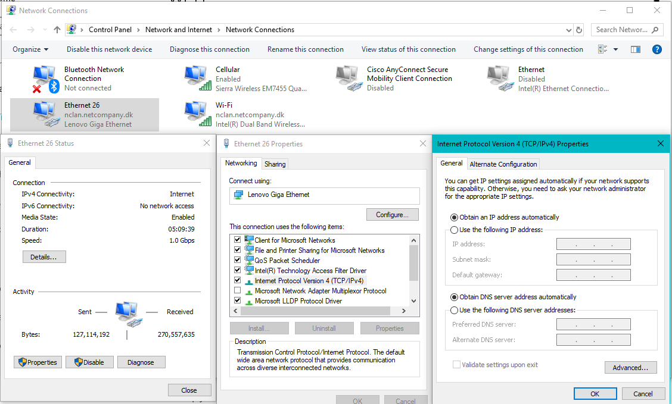
Network Settings

Slide 22
HTTP Stack
Other alternatives exist
Layer
Example
Alternative
Application
Browser
App
Application Layer
HTTP
HTTPS
Transport layer
TCP
UDP
Network layer
IP
IP
Link layer
Ethernet Driver
WiFi Driver
Hardware layer
Ethernet
WiFi chip

Slide 23
IP
IP is the address protocol
IPv4 is the most commonly used protocol today
IPv4 uses 32-bit addresses (2³²)
Defined by 4 sets of 3 digits, divided by dots
Ports are supplied after a comma
Path is defined after a slash
123.321.12.3:80/folder
The subnet mask defines the local networking range
127.0.0.0 is usually your localhost
192.168 and 10.0 addresses are usually used for LAN
IPv6 is the latest version of the protocol
Uses 128-bit addresses (2¹²⁸)
Defined by 8 sets of 4 hex digits, where 0000 can be omitted
12fa:32ff: : : :0291: : 9de1

Slide 24
TCP
Handles connection handshakes
Handles data packages

Slide 25
HTTP
Contents:
Verb
Resource
Version
Headers
Status
Body
Request:
GET /address/ HTTP/1.1
Accept: text/html
Response:
HTTP/1.1 200 OK
Content-type: text-html
<!DOCTYPE html>
<html lang=“en”>
…

Slide 26
HTTP Verbs
GET
Retrieve data (from server to client)
Should have no side effects
Parameters in resource (URI)
POST
Send data (from client to server)
Parameters in body
PUT
Replace data (sent from client to server)
DELETE
Removes data
GET, PUT & DELETE are idempotent

Slide 27
HTTP Verbs
HEAD
Same as GET, but transfers status and header only
CONNECT
Establishes a tunnel identified by URI
OPTIONS
Describes communication options for target
TRACE
Performs a message loop-back test along the path to the target
Let’s try CMD tracert

Slide 28
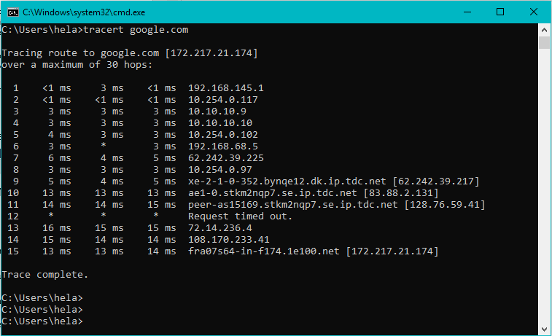
Trace

Slide 29
HTTP Resource
Regular
gp?product=1234&comment=4321
url?key1=value1&key2=value2&key3=value3
RESTful
gp/product/1234/comment/4321

Slide 30
HTTP Version
Different versions have different behavior:
1991: HTTP 0.9
Single line protocol with no headers.
Only GET supported: GET index.html
1996: HTTP 1.0
Added headers, and a version string
1999: HTTP 1.1
Connection keep-alive by default
Additional caching mechanisms
Primary HTTP version used today
2015: HTTP 2.0
Binary framing
Header compression
General optimizations

Slide 31
HTTP Headers
Request specific format:
Request secondary format if first is not available
Request preferred encoding
Request preferred language
User-Agent (usually set by browser)
Accept: text/html
Accept: application/json,application/xml
Accept-Encoding: bzip2,gzip
Accept-Language: dk, es, en-US
User-Agent: Mozilla/5.0 (Windows NT 10.0; Win64; x64) AppleWebKit/537.36 (KHTML, like Gecko) Chrome/71.0.3578.98 Safari/537.36

Slide 32
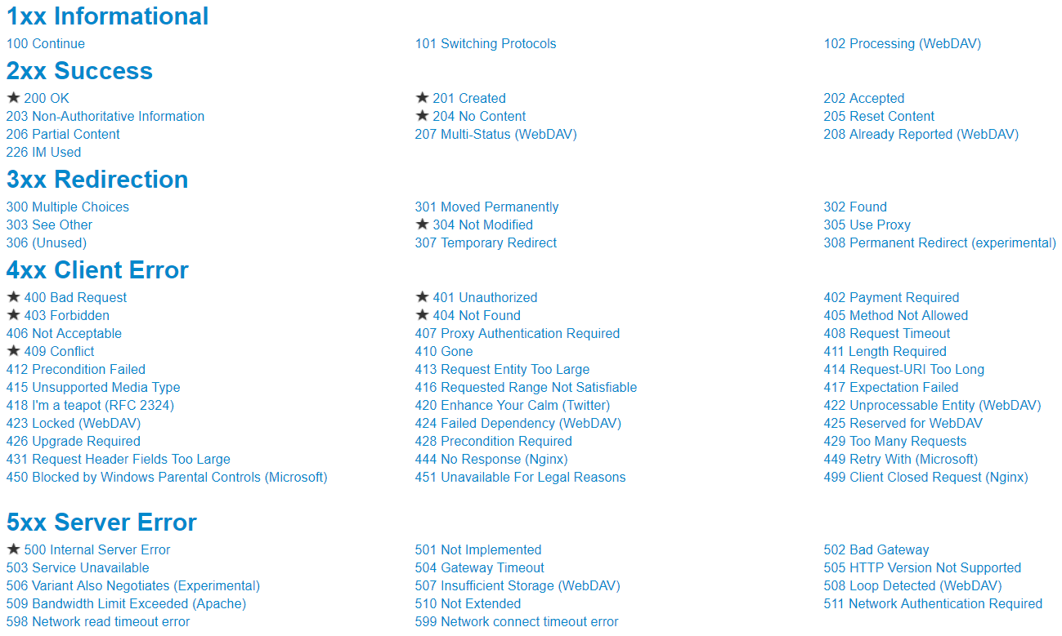
HTTP Status Codes
Source: https://www.restapitutorial.com/httpstatuscodes.html

Slide 33
HTTP Request Body
PUT & POST request typically have a body. HTML forms usually results in a POST request with a x-www-form-urlencoded type
POST /post HTTP/1.1
Host: url.org
User-Agent: Mozilla/5.0 (Windows NT 10.0; Win64; x64) AppleWebKit/537.36 (KHTML, like Gecko) Chrome/71.0.3578.98 Safari/537.36
Accept: */*
Content-Length: 18
Content-Type: application/x-www-form-urlencoded
user=bo&comment=Hi

Slide 34
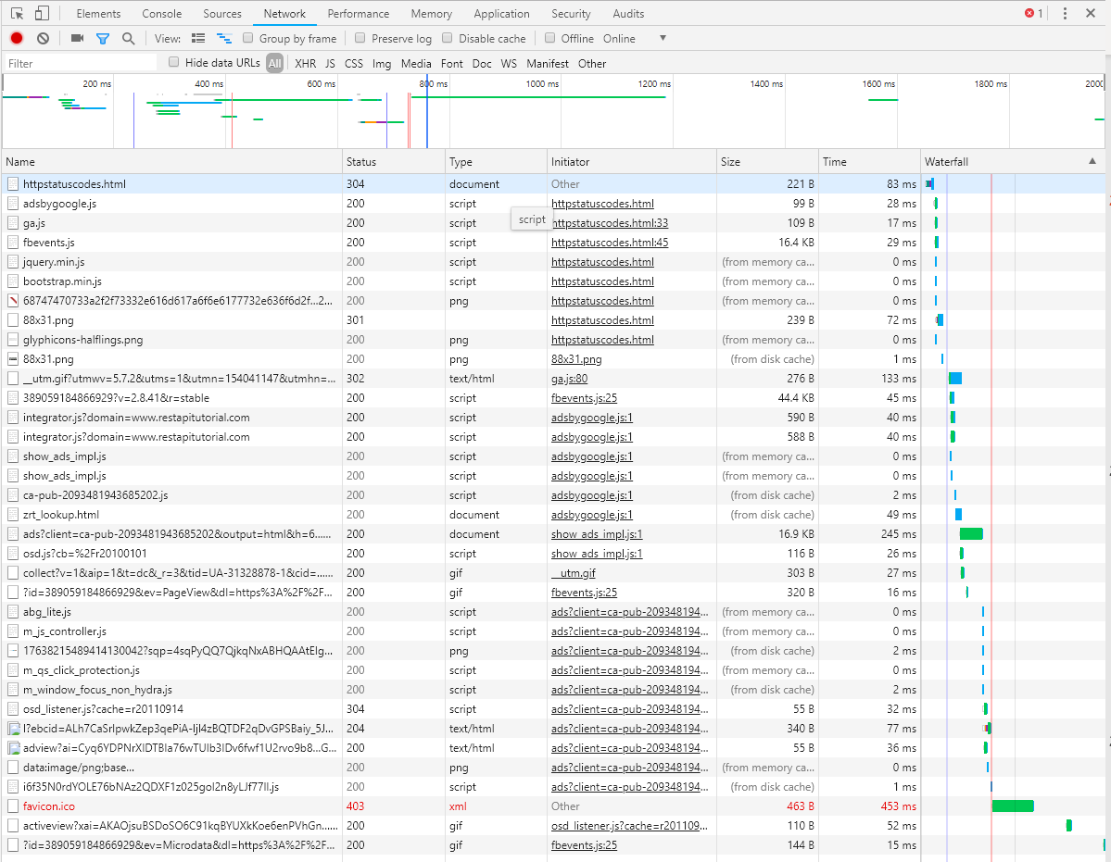
HTTP in action
Let’s try Chromes “network” tab

Slide 35
HTTP vs HTTPS
HyperText Transfer Protocol Secure:
Means trusted SSL certificate is in place
Anyone can get one
TLS is an updated version, but we still call it SSL
Stands for Secure Socket Layer, Transport Layer Security
Requests and responses are scrambled and encrypted
Stored data is not
Uses port 443 instead of port 80
Increases SEO ranking
Browsers warn users not to use HTTP
https://www.guru99.com/difference-http-vs-https.html

Slide 36
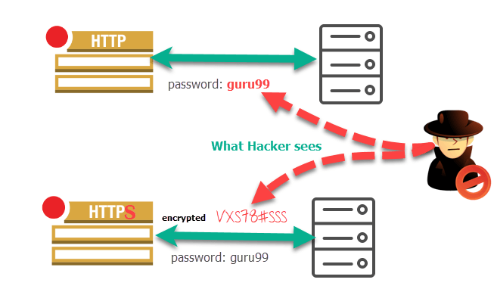

HTTP vs HTTPS
Source: https://www.guru99.com/difference-http-vs-https.html

Slide 37
Other Protocols
FTP
File transfer protocol
Default way of working with files on the server
SMTP
Simple Mail Transfer Protocol
Default way of sending and receiving e-mails

Slide 38
The URL
http://www.fuzzball.nu/Project/simplevote/index.html
HTTP protocol
World-wide-web (indicates website)
Domain name
Top-level domain
Mapping on server
Specific file
If this address is a file path, the index.html file will be loaded automatically if it exists
This can easily be disabled

Slide 39
Sessions & Cookies
Sessions are stored on the server
invisible to the user
Reliable
Cookies are stores on the client and thus
Visible and editable by
User
Every other website
Commonly used by spyware
Sessions expire when the browser is closed
Session timeouts can be set
Session ID’s are stored in cookies
SESSION
Response
Request
COOKIE

Slide 40
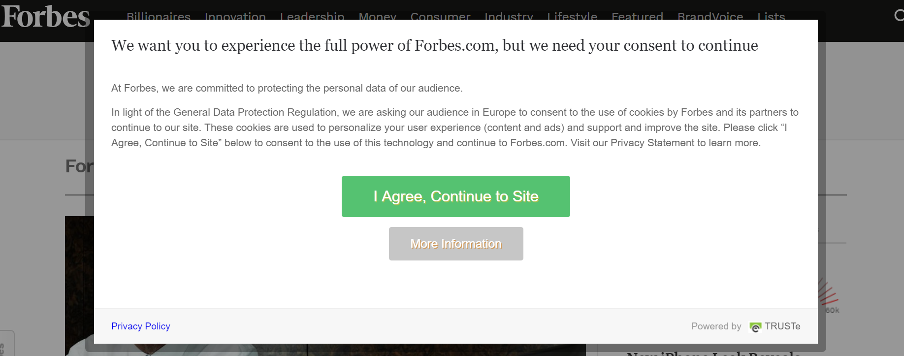
Sessions & Cookies
Sites must warn you about Cookies
Why?
Why not Sessions?

Slide 41
Break!
And afterwards, we will continue with:
PHP

Slide 42
PHP
Personal Home Page Hypertext Preprocessor
Backend language – runs server side
Defines the content that is sent to the Client

Slide 43
How do we run it?
Open the folder that contains your project in Terminal or CMD
Use the following command:
Php –S localhost:8080
Localhost can be

Slide 44
PHP
A PHP file has the extension .php
.php files are interpreted by an Apache server
index.php is loaded by default
.php files can be seen as HTML files with a special PHP element <?php ?>
<?php
/* This is a PHP comment */
// This is also a PHP comment
# And so is this
?>

Slide 45
PHP
The PHP is functional and will not be present in the generated HTML
To write something that should be included in the HTML
Use echo
echo ‘Hello World!’;
Or exit the PHP ( ?> )

Slide 46
PHP
Combined with HTML example:
<h1><?php echo ‘Hello World’; ?></h1>

Slide 47
PHP
Altlhough PHP variable names are case-sensitive, function names and keywords are not.
PHP has Integer, Double, String (single or double quotes) and Boolean primitive types.
Inside double quotes a variable is replaced by its value (this is called variable interpolation).
PHP arrays can be viewed either as “ordinary” arrays with integer indexes, or as a list of key/value pairs.

Slide 48
PHP Variables
PHP variables are noted with a dollar sign: $
PHP variables are similar to JavaScript variables
The type is not set
The type can be changed by new assignment
But there is a difference
PHP variables have no initializer
JavaScript:
var number = “2”;
number = parseInt(number);
>> 2
PHP:
$number = “2”;
$number = intval($number);
>> 2

Slide 49
Strings
Strings can be enclosed in single or double brackets
Double quotes are considered regular characters in a single-quote string and vice versa
This is also true for JavaScript!
Escape characters are also as you might expect
\” \’ \n \r \t \$ \\
echo ‘He said “Hello”.’;
echo “Don’t do it!“;

Slide 50
Strings and variables
$a = 4;
$b = 5;
echo $a + $b; >> 9
echo $a . $b; >> 45
Strings can be concatenated with + or .
+ is generally mathematical
. Is always concatenation
. is considered best practice for concatenation
A variable can be resolved directly inside a double-quoted string – not a single-quotes one
This is called interpolation
To avoid confusion, the variable can be wrapped in curly brackets
echo ‘Hello, ’ . $name;
$name = “Manny”;
echo ‘We have a $name’; >> We have a $name
echo “We have a $name”; >> We have a Manny
echo “We have 2 $names”; >> ERROR
echo “We have 2 {$name}s”; >> We have 2 Mannys

Slide 51
Strings and variables
Echo’s and non-PHP is treated equally
There is a convenience method for entering PHP to echo a variable
<?php echo “Hello <b>$name</b>”; >> Hello Manny
Hello <b><?php echo $name; ?></b> >> Hello Manny
Hello <b><?=$name?></b> >> Hello Manny

Slide 52
Strings functions
PHP has a lot of built-in functions and they are not tied to classes as you might expect.
Complete list:
https://www.w3schools.com/php/php_ref_string.asp
substr
strlen
substr
substr_replace
strtolower
strtoupper
htmlentities
explode / str_split
implode / join
ltrim
md5
Hashing method
preg_match ($pattern, $string)
Regex matcher

Slide 53
Math functions
Complete list:
https://www.w3schools.com/php/php_ref_math.asp
abs: absolute value
cos / acos
sin / asin
tan / atan
sqrt : square root
pow : x to the power of y
rand : random
floor : rounds float down to int
round : rounds float to int
pi

Slide 54
PHP Arrays
Arrays in PHP can have key / value pairs
Values can be accessed via key or index:
To add an item to the array
To add new key/value set
To remove a key/value set
To check if a value is set
$array = array(“key” => “value”, “foo” => 3, “x”);
$array[2]; >> “x”
$array[“key”]; >> “value”
$array[] = “new item”;
$array[“new key”] = [“new value”];
unset($array[“new key”]);
isset($array[“new key”]);

Slide 55
PHP Arrays
To see all contents of a PHP array
Values can be accessed via key or index:
print_r($array)

Slide 56
Functions
Create and call a function
As with JavaScript, we do not specify type
Note that built-in functions are called directly
strlen($myString);
function sum($a, $b) {
return $a + $b;
}
echo sum(2, 2); >> 4
echo sum(“2”, “2”) >> 22

Slide 57
Expressions and evaluators
Mathematical expressions are the same as Java:
+ - * / %
Usual comparisons are as expected, but we there are more:
== != < <= > >=
!== === match value and type
<> not equal, value only
<=> returns -1 0 or 1, depending on whether the left argument is lower than, equal to or higher than the right argument

Slide 58
If-Then-Else
Can be written in two different ways, to match your HTML style:
if($name === "Manny") {
echo 'Hi Mr. M';
} elseif ($name === "Jackie") {
echo 'Hi Mrs. J';
} else if ($name === "Bo") {
echo "Hi Mr. B";
} else {
echo "Hi $name";
}
if($name === "Manny") : ?>
Hi Mr. M
<?php elseif ($name === "Jackie") : ?>
Hi Mrs. J
<?php elseif ($name === "Bo") : ?>
Hi Mr. B
<?php else : ?>
Hi <?=$name?>
<?php endif; ?>

Slide 59
Switch
Can be written in two different ways, to match your HTML style:
switch($name) {
case "Manny":
echo "Hello Mr. M";
break;
case "Jackie":
echo "Hello Mrs. J";
break;
default:
echo "Hello $name";
}
switch($name) :
case "Manny":
echo "Hello Mr. M";
break;
case "Jackie":
echo "Hello Mrs. J";
break;
default:
echo "Hello $name";
endswitch;

Slide 60
Loops
Can be written in two different ways, to match your HTML style:
for($i = 0; $i < sizeOf($names); $i++) {
echo $names[$i] . ", ";
}
for($i = 0; $i < sizeOf($names); $i++) :
echo $names[$i] . ", ";
endfor;
foreach ( $names as $key => $value ) {
echo $key . " " . $value . ", ";
}
foreach ( $names as $key => $value ) :
echo $key . ", " . $value;
endforeach;
foreach ( $names as $value ) {
echo $value . ", ";
}
foreach ( $names as $value ) :
echo $value;
endforeach;

Slide 61
Loops
Can be written in two different ways, to match your HTML style:
$i = 0;
while($i < sizeof($names)) {
echo $names[$i] . ", ";
$i++;
}
$i = 0;
while($i < sizeof($names)) :
echo $names[$i] . ", "
$i++;
endwhile;
$i = 0;
do {
echo $names[$i] . ", ";
$i++;
} while ($i < sizeof($names));

Slide 62
PHP Super Globals
PHP has a set of “Super Global” Variables
They are accessible from anywhere, regardless of scope
Remember that print_r() can show an arrays content!
$GLOBALS
$_SERVER
$_REQUEST
$_POST
$_GET
$_FILES
$_COOKIE
$_SESSION

Slide 63
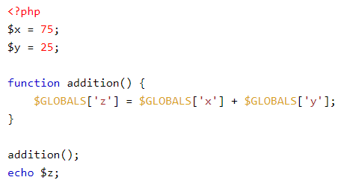
$GLOBALS
Contains all global variables from anywhere:
>> 100

Slide 64
$_SERVER
Holds information about headers, paths, and script locations
We will use this to manipulate URL’s later on
$_SERVER['PHP_SELF'] | Returns the filename of the currently executing script
$_SERVER['GATEWAY_INTERFACE'] | Returns the version of the Common Gateway Interface (CGI) the server is using
$_SERVER['SERVER_ADDR'] | Returns the IP address of the host server
$_SERVER['SERVER_NAME'] | Returns the name of the host server (such as www.w3schools.com)
$_SERVER['SERVER_SOFTWARE'] | Returns the server identification string (such as Apache/2.2.24)
$_SERVER['SERVER_PROTOCOL'] | Returns the name and revision of the information protocol (such as HTTP/1.1)
$_SERVER['REQUEST_METHOD'] | Returns the request method used to access the page (such as POST)
$_SERVER['REQUEST_TIME'] | Returns the timestamp of the start of the request (such as 1377687496)
$_SERVER['QUERY_STRING'] | Returns the query string if the page is accessed via a query string
$_SERVER['HTTP_ACCEPT'] | Returns the Accept header from the current request
$_SERVER['HTTP_ACCEPT_CHARSET'] | Returns the Accept_Charset header from the current request (such as utf-8,ISO-8859-1)
$_SERVER['HTTP_HOST'] | Returns the Host header from the current request
$_SERVER['HTTP_REFERER'] | Returns the complete URL of the page from which the current page was called

Slide 65
$_SERVER
Holds information about headers, paths, and script locations
We will use this to manipulate URL’s later on
$_SERVER['HTTPS'] | Is the script queried through a secure HTTP protocol
$_SERVER['REMOTE_ADDR'] | Returns the IP address from where the user is viewing the current page
$_SERVER['REMOTE_HOST'] | Returns the Host name from where the user is viewing the current page
$_SERVER['REMOTE_PORT'] | Returns the port being used on the user's machine to communicate with the web server
$_SERVER['SCRIPT_FILENAME'] | Returns the absolute pathname of the currently executing script
$_SERVER['SERVER_ADMIN'] | Returns the value given to the SERVER_ADMIN directive in the web server configuration file (if your script runs on a virtual host, it will be the value defined for that virtual host) (such as someone@w3schools.com)
$_SERVER['SERVER_PORT'] | Returns the port on the server machine being used by the web server for communication (such as 80)
$_SERVER['SERVER_SIGNATURE'] | Returns the server version and virtual host name which are added to server-generated pages
$_SERVER['PATH_TRANSLATED'] | Returns the file system based path to the current script
$_SERVER['SCRIPT_NAME'] | Returns the path of the current script
$_SERVER['SCRIPT_URI'] | Returns the URI of the current page

Slide 66
$_REQUEST, $_GET & $_POST
Used to collect data after HTML form is submitted
$_GET contains the content of a request when the HTTP request type is GET
$_POST contains the content of a request when the HTTP request type is POST
$_REQUEST contains the content of a request no matter which HTTP method was used
Use $_SERVER[“REQUEST_METHOD”] to find out which method was used

Slide 67
$_REQUEST, $_GET & $_POST
a.php:
<form method=“post” action=“b.php”>
<input name=“vname” value=“hello”/>
</form>
b.php:
<?php
echo $_POST[“vname”]; >> hello
echo $_REQUEST[“vname”]; >> hello
echo $_GET[“vname”]; >>

Slide 68
$_FILES
$_FILES contains files and file metadata from a request
Full example: https://www.w3schools.com/php/php_file_upload.asp
You can tailor this example for your projects
I expect more than just a copy
We will discuss that part further next week with databases
Check files size, file extension, mime type
Let’s take a look!

Slide 69
Filesystem
PHP is the functional gateway between the clients and the server
Filesystem access
Database access
Create, rename and delete files and folders
PHP filesystem functions:
https://www.w3schools.com/php/php_ref_filesystem.asp
Let’s have a look
More next week!

Slide 70
$_COOKIE
Used to store information in a cookie on the client machine
Remember that anything inside a cookie can be altered by a user!

Slide 71
$_SESSION
Contains information specific to a user
A cookie shares an ID, so the session can identify the user and select the right session
The data in a session is stored on the server
The user does not have direct access to the data in a session
When you create your login systems, you can set something like
$_SESSION[“logged_in”] = true;
And check it with something like
If(isset($_SESSION[“logged_in”] && $_SESSION[“logged_in”])
We will get back to logging in when we talk about databases next week

Slide 72
$_SESSION
A session needs to be initialized
if (session_status() == PHP_SESSION_NONE) {
session_start();
}

Slide 73
Filter Sanitize
You can sanitize your request data to make sure it is the format you expect and not malicious
filter_input(INPUT_GET, "email", FILTER_VALIDATE_EMAIL)
Complete list of sanitize filters here
http://php.net/manual/en/filter.filters.sanitize.php
I expect all user input to be sanitized
Let’s have a look at that list

Slide 74
HTML Entities
Sometimes you may want to accept codes, but in most cases, you will not
To change a request string into using HTML Entities, use the method htmlentities
htmlentities($_POST[“username”])
When you both sanitize and use htmlentities, you sanitize first!
This is used to avoid XSS (Cross Site Scripting)
Let’s try it!

Slide 75
include and require
The purpose of PHP is to build the HTML the server should send to the client
Sometimes a chunk of code should be repeated
include creates warning if it fails, require throws fatal error
include_once and require_once only includes if content has not already been included
include ‘myFile.php’;
include_once ‘myFile.php’;
require ‘myFile.php’;
require_once ‘myFile.php’;

Slide 76
Debugging and development
During development, put this PHP function call at the beginning of your code to receive error reports.
error_reporting(E_ALL)
When you are happy with the script, turn off error reporting
error_reporting(0).

Slide 77
Exercise
You can use this exercise in your first assignment
Create an HTML form that can POST a username and a password
For now, just check the inputs with hardcoded values
if($_POST[“username”] == “john”)
When you are logged in, there should be an option to log out
When you are not logged in, the HTML form should be included

Slide 78
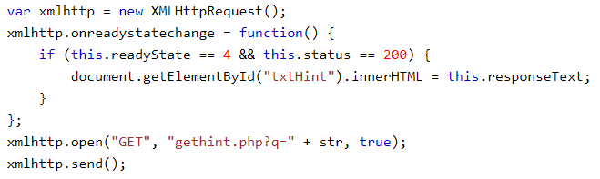
AJAX
We use JavaScript to change a page after it has loaded
This might be done by retrieving more data from the server
That is done with AJAX
Full example: https://www.w3schools.com/php/php_ajax_php.asp

Slide 79
Exercise
Make an AJAX call that gets a random number from the server every second and puts it on the page
Javascript hint:
setInterval
PHP hint:
rand()

Slide 80
Next time we talk PHP
Objects
JSON
XML
.htaccess
Tokens
API’s
Creation
Consumption

Slide 81
TRY IT OUT!
Next time, we will continue with:
MySQL
Please install MariaDB if you have not already

